Slide 1
Intrusion Detection System(IDS)
Project Proposal Presentation
by
Josaiah Murfeal Dkhar(2447125)
Pranab Rai(2447137)
II MCA-A
Project Guide
Dr. Tegil John
Department of Computer Science
CHRIST(Deemed to be University), Bengaluru-29

Slide 2
Agenda
Introduction
Need analysis
Social impact
Alignment with SDG Goals
Existing Systems
Proposed System
Feasibility Analysis
Benefits of Proposed System
Requirement description
Analysis modelling
Plan of Work
Anticipated Outcomes
References

Slide 3
Introduction
The project aims to develop an advanced Intrusion Detection System (IDS) that uses machine learning and heuristic algorithms to provide real-time, adaptive detection of cyber threats, including both known and unknown intrusions. With a focus on detecting complex attacks like Advanced Persistent Threats (APTs) and AI-driven malware, this IDS will address limitations of existing systems by enhancing accuracy, scalability, and integration capabilities.
Requirement Analysis: The need for an adaptive IDS stems from increasing cyber threats that exploit traditional systems' limitations. Essential requirements include robust data processing, machine learning integration, compatibility with cloud and IoT networks, and a user-friendly interface for security administrators. High-performance hardware and open-source software tools like Snort will support real-time processing and detection.
Viability, Novelty, and Relevance: The project is viable due to advancements in machine learning algorithms, which enable systems to detect previously unseen attack patterns. This IDS stands out by integrating deep learning, hybrid detection methodologies, and user behavior analytics, making it both innovative and practical. In alignment with SDG Goal 9 (Industry, Innovation, and Infrastructure) and Goal 16 (Peace, Justice, and Strong Institutions), this project aims to strengthen digital infrastructure resilience and security.

Slide 4
Need Analysis
1. Limitations of Traditional IDS:
Traditional IDS struggles with sophisticated cyberattacks, high traffic volumes, and evolving threats.
Signature-based systems can only detect known threats, while anomaly-based systems often generate high false positives.
2. Real-Time Threat Detection and Response:
Growing network traffic and attack speeds necessitate real-time monitoring and response.
Traditional IDS may not meet the real-time demands of modern network environments.
3. Adaptability to Evolving Cyber Threats:
Attackers continually develop new methods, requiring an IDS that adapts and learns from emerging threats.
Machine learning and external threat intelligence feeds are key to maintaining up-to-date detection capabilities.

Slide 5
4. Scalability and Resource Efficiency:
The IDS must scale with growing network sizes while managing the resource demands of advanced detection techniques.
Balancing detection capabilities with computational efficiency is essential for real-time performance.
5. Integration with Existing Security Infrastructure:
Seamless integration with firewalls, antivirus software, and other security measures is necessary for a layered security approach.
Coordination between security layers enhances overall protection.
7. User-Friendly Interface and Reporting:
The IDS should provide a clear and intuitive interface for administrators to manage security incidents.
Comprehensive reporting tools are essential for incident analysis, trend tracking, and regulatory compliance.

Slide 6
Social Impact
1. Increased Network Security and Data Protection:
Enhances network security by detecting and responding to threats in real-time.
Protects sensitive personal and financial data, reducing risks of breaches and financial losses.
Integration with existing security measures strengthens overall cybersecurity.
2. Improved Incident Response and Reduced Damage:
Real-time threat detection enables quicker responses to mitigate damage and prevent attack spread.
Combines signature-based and anomaly-based detection for more effective threat management.
3. Enhanced User Trust and Confidence:
A robust IDS boosts user trust in digital systems and online platforms.
Promotes confidence by safeguarding user data and preventing attacks.
User behavior analytics enhance detection of insider threats, further building trust.

Slide 7
4. Challenges and Potential Negative Impacts:
False positives and negatives may cause unnecessary alerts or missed threats, affecting user experience.
Data bias in machine learning models could impact the system’s fairness and accuracy.
Privacy concerns may arise due to monitoring capabilities if not responsibly managed.

Slide 8


Alignment with SDG Goals
SDG 9: Industry, Innovation, and Infrastructure By developing a sophisticated IDS, this project supports resilient IT infrastructure, fostering innovation in cybersecurity solutions that protect critical infrastructure and Industries from digital threats.
SDG 16: Peace, Justice, and Strong Institutions The IDS enhances institutional security, helping organizations safeguard data integrity and protect against attacks, thus contributing to a stable and secure digital ecosystem.

Slide 9
Existing Systems
Snort
Snort is one of the most widely used open-source, signature-based IDS solutions. It monitors network traffic in real-time and uses predefined attack signatures to detect known threats.
Limitations:
Signature-Based Only: Snort can only detect attacks that match its existing database of signatures, meaning it struggles to identify unknown or zero-day threats.
High False Negatives: Because it relies solely on known signatures, Snort may miss novel or modified attacks that deviate from recognized patterns.
Scalability Issues: Snort was not originally designed to scale across large, dynamic environments like cloud networks or IoT ecosystems, limiting its applicability in modern, distributed systems.

Slide 10
OSSEC (Open Source Security)
Overview: OSSEC is a free, open-source host-based IDS that provides log analysis, integrity checking, and rootkit detection for endpoint security. It’s commonly used to monitor system logs for suspicious activity on host systems.
Limitations:
Limited Network Monitoring: OSSEC is host-based and does not monitor network traffic directly, limiting its ability to detect network-wide threats.
False Positives in Complex Environments: OSSEC often generates false positives in complex environments where regular system activity might mimic suspicious patterns, such as dynamic IP environments in cloud infrastructures.
Resource Intensive on Hosts: OSSEC can consume substantial resources on host systems, which may impact performance, particularly for resource-constrained devices.

Slide 11
Proposed System
Functional Description: The proposed IDS will utilize a hybrid detection methodology that combines signature-based and anomaly-based detection with stateful protocol analysis. It will incorporate machine learning algorithms, particularly Recurrent Neural Networks (RNNs), to adaptively detect threats across a variety of network environments.
Proposed Solution Architecture: The system will consist of the following components:
Data Collection Layer: Uses network monitoring tools and logs to gather data.
Feature Extraction Module: Processes network traffic, extracting features like protocol type, session duration, and packet size.
Machine Learning Module: Applies supervised and unsupervised algorithms to classify and detect anomalies.
Alert Mechanism and Response System: Generates alerts based on thresholds and provides administrators with insights and remediation options.
Feedback Loop: Continuously retrains models with new data to improve detection accuracy.

Slide 12
Feasibility Analysis
Software and Hardware Requirements:
Software: Python, TensorFlow, Scikit-learn, Snort, MySQL/MongoDB.
Hardware: Servers with Intel Xeon or AMD EPYC processors, 32 GB RAM, SSD storage, and high-bandwidth NICs for real-time data processing.
Time: The project will follow a structured timeline over five months, divided into phases for requirements analysis, system design, coding, testing, and deployment.
Cost: This project primarily relies on open-source tools, with major costs stemming from server hardware, machine learning libraries, and implementation resources.
Implementation Issues: Potential challenges include ensuring compatibility with existing security systems, managing computational requirements for real-time processing, and addressing privacy concerns when monitoring network traffic.

Slide 13
Benefits of Proposed System
Project Goals and Objectives:
Real-Time Monitoring: Providing continuous monitoring to detect intrusions as they happen.
Adaptive Threat Detection: Utilizing machine learning for detecting unknown threats and reducing false positives.
User Behavior Analysis: Enabling insights into user activity to detect insider threats.
Scalability: Ensuring system adaptability to different network sizes, including IoT and cloud environments.
Enhanced Integration: Compatibility with existing security measures like firewalls and antivirus solutions.

Slide 14
Requirement description
Functional Requirements (What the system should do):
Detection of Unauthorized Access: Identify and flag illegitimate attempts to access network resources.
Real-Time Anomaly Detection: Monitor network activity in real time to detect deviations and potential intrusions.
Threat Identification: Detect both known (signature-based) and unknown (machine learning-based) threats.
Incident Response Enhancement: Provide actionable insights and alerts to assist security personnel in responding to threats.
Adaptation to Changing Threats: Continuously learn from new data and update detection algorithms.
User Behavior Analytics: Analyze user behavior to detect insider threats and compromised accounts.
Integration with Existing Security Infrastructure: Seamlessly work with firewalls and antivirus software for a coordinated defense.
Reporting and Compliance: Provide detailed reports for security trend analysis, regulatory compliance, and policy improvement.
Scalability: Scale to handle growing network traffic and new endpoints without compromising performance.

Slide 15
Non-Functional Requirements (How the system should be):
Performance:
Real-Time Processing: Ensure immediate threat detection and response.
High Detection Rate: Accurately detect a high percentage of intrusions while minimizing false positives.
Low False Positive Rate: Minimize false alarms to avoid alert fatigue.
Reliability: Ensure consistent operation for continuous threat monitoring.
Availability: Provide uninterrupted security monitoring with minimal downtime.
Security: Protect the IDS itself from attacks to maintain system integrity.
Usability: Provide a user-friendly interface for administrators to manage and monitor the system.
Maintainability: Design the system for easy updates, bug fixes, and configuration changes.
Portability: Ensure compatibility with different operating systems and hardware platforms.
Compliance: Meet relevant cybersecurity regulations and standards for data protection.
Resource Efficiency: Optimize use of computational resources for better performance and scalability.

Slide 16
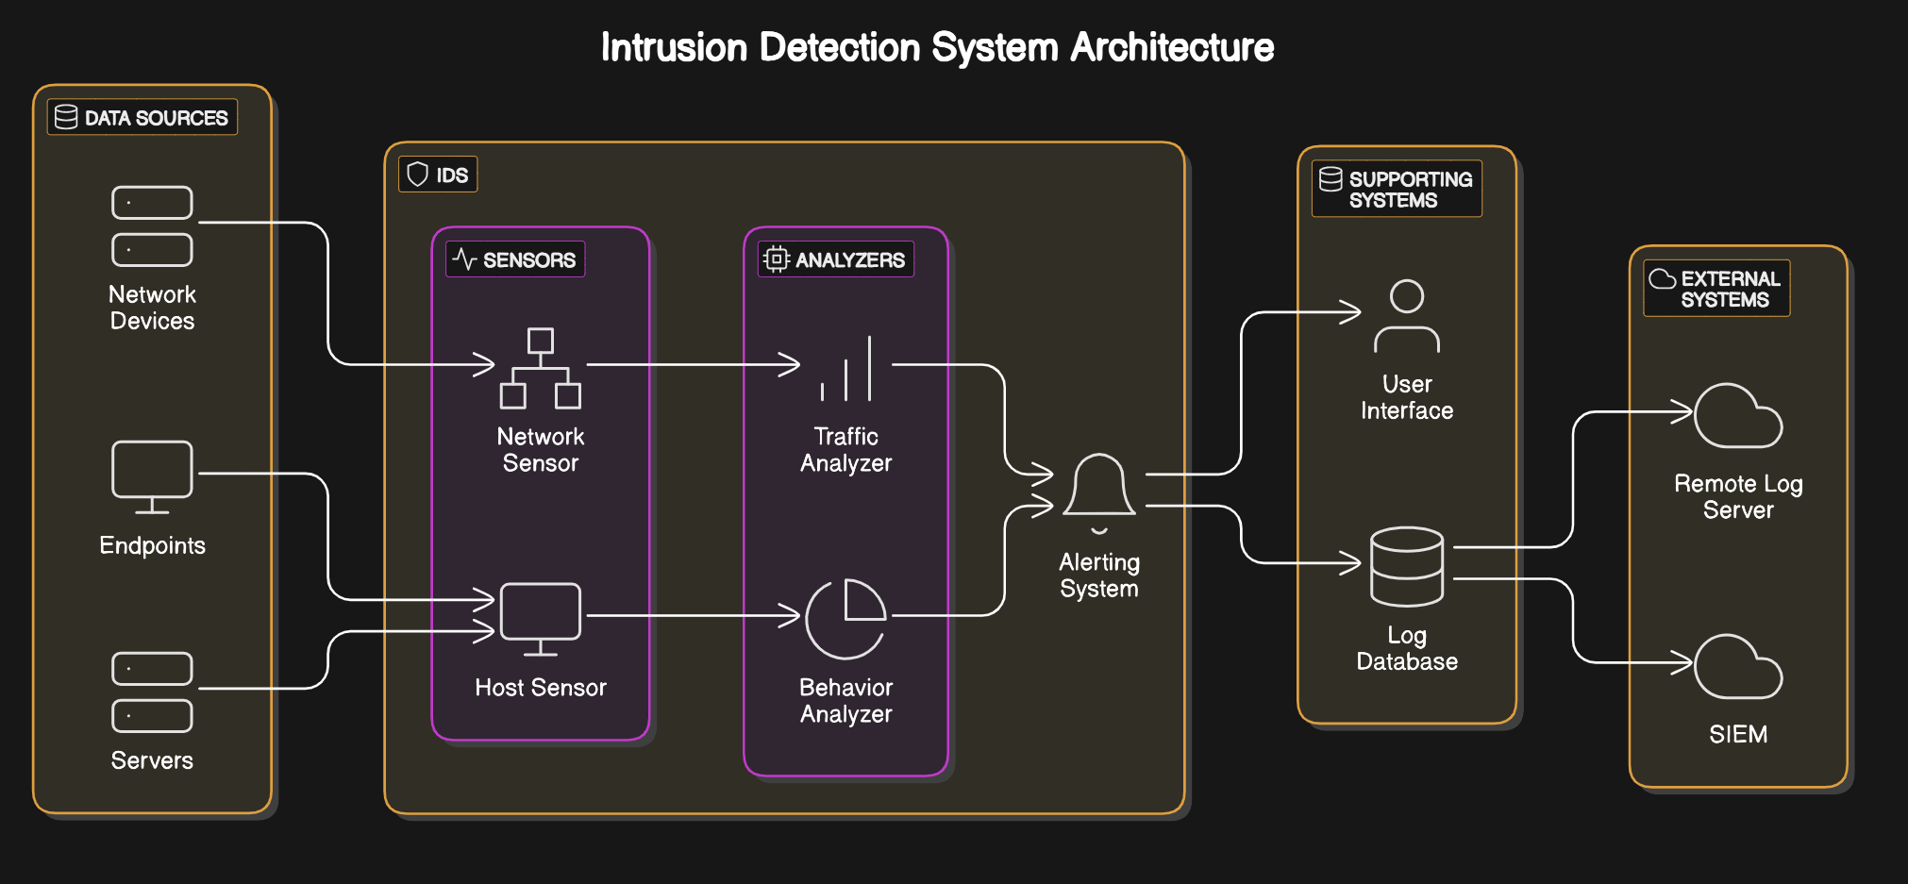
Analysis modelling
Architecture Diagram

Slide 17
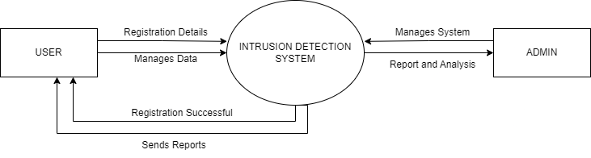
Data Flow Diagram
Level 0

Slide 18
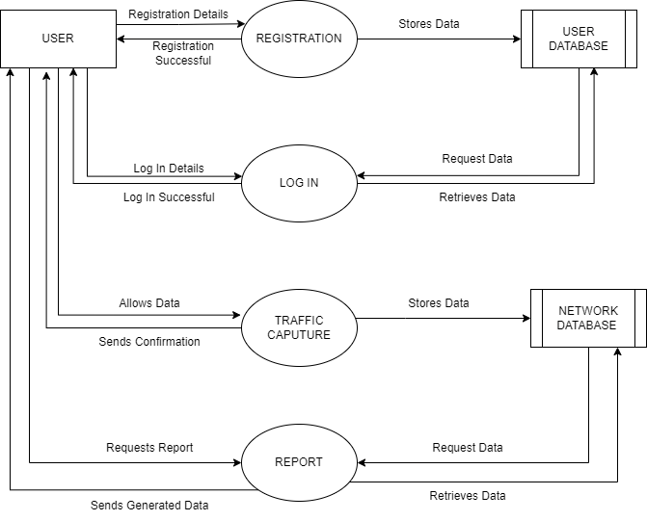
Level 1 User DFD

Slide 19
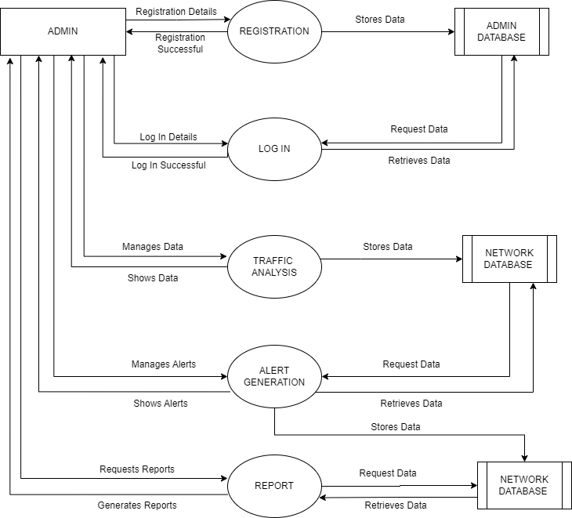
Level 1 ADMIN DFD

Slide 20
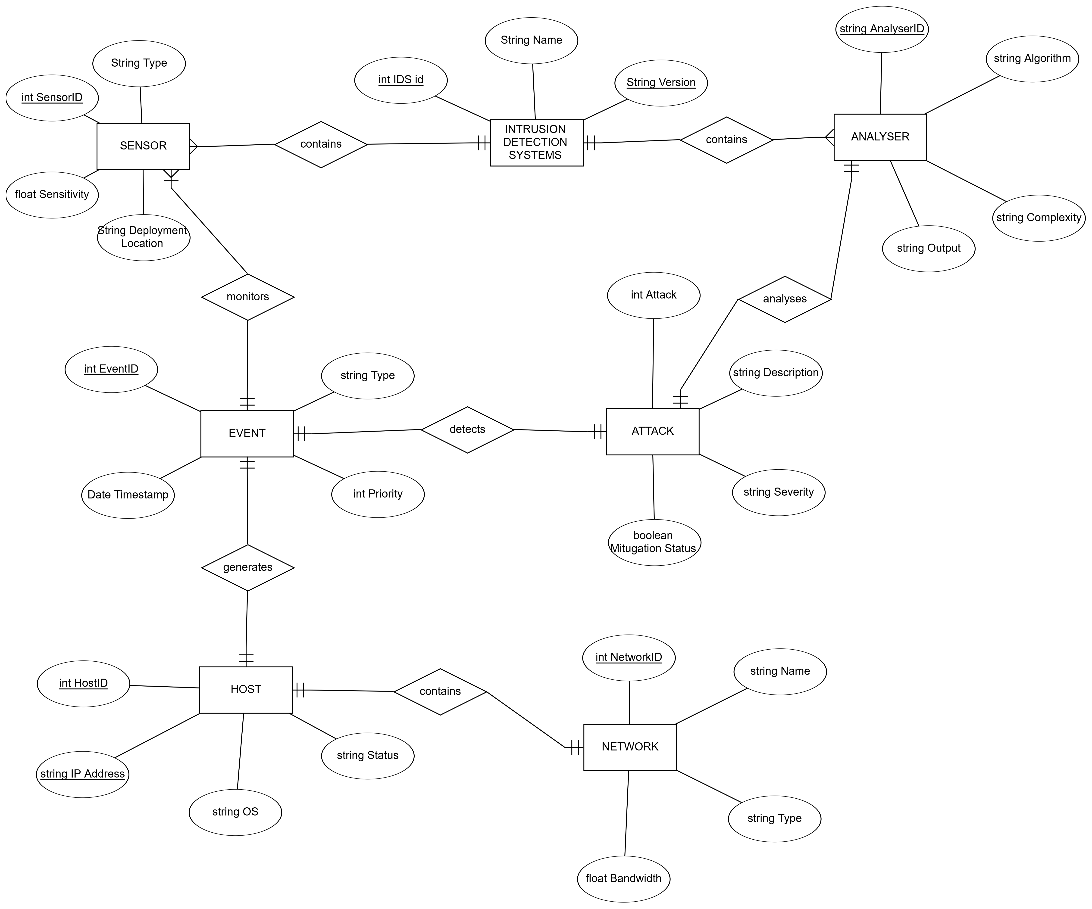
Entity Relationship Diagram

Slide 21
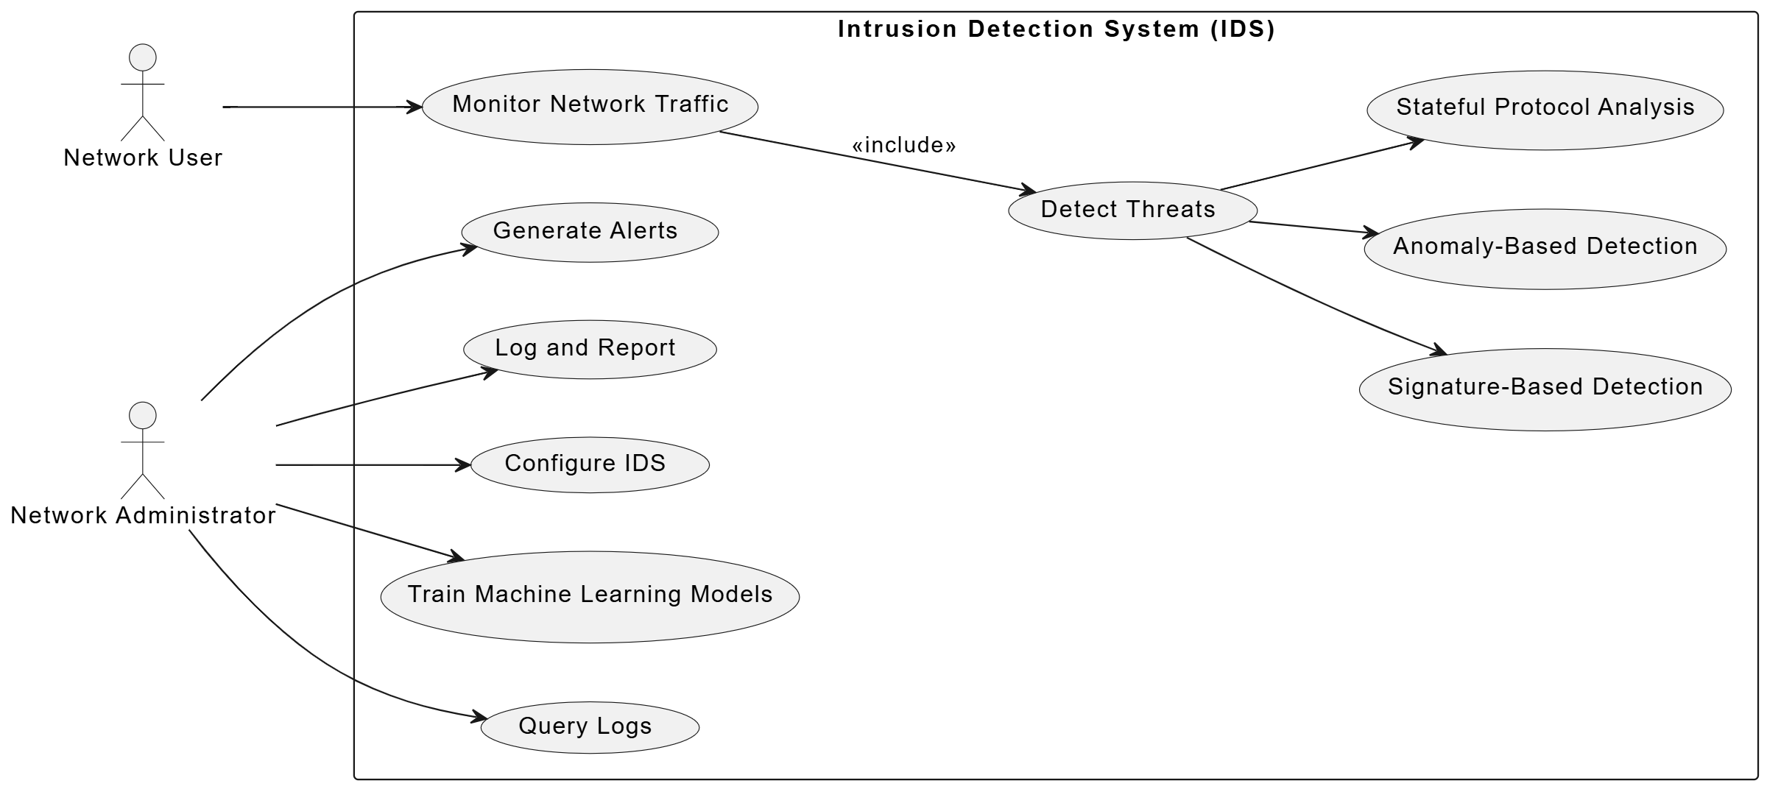
Use Case Diagram

Slide 22
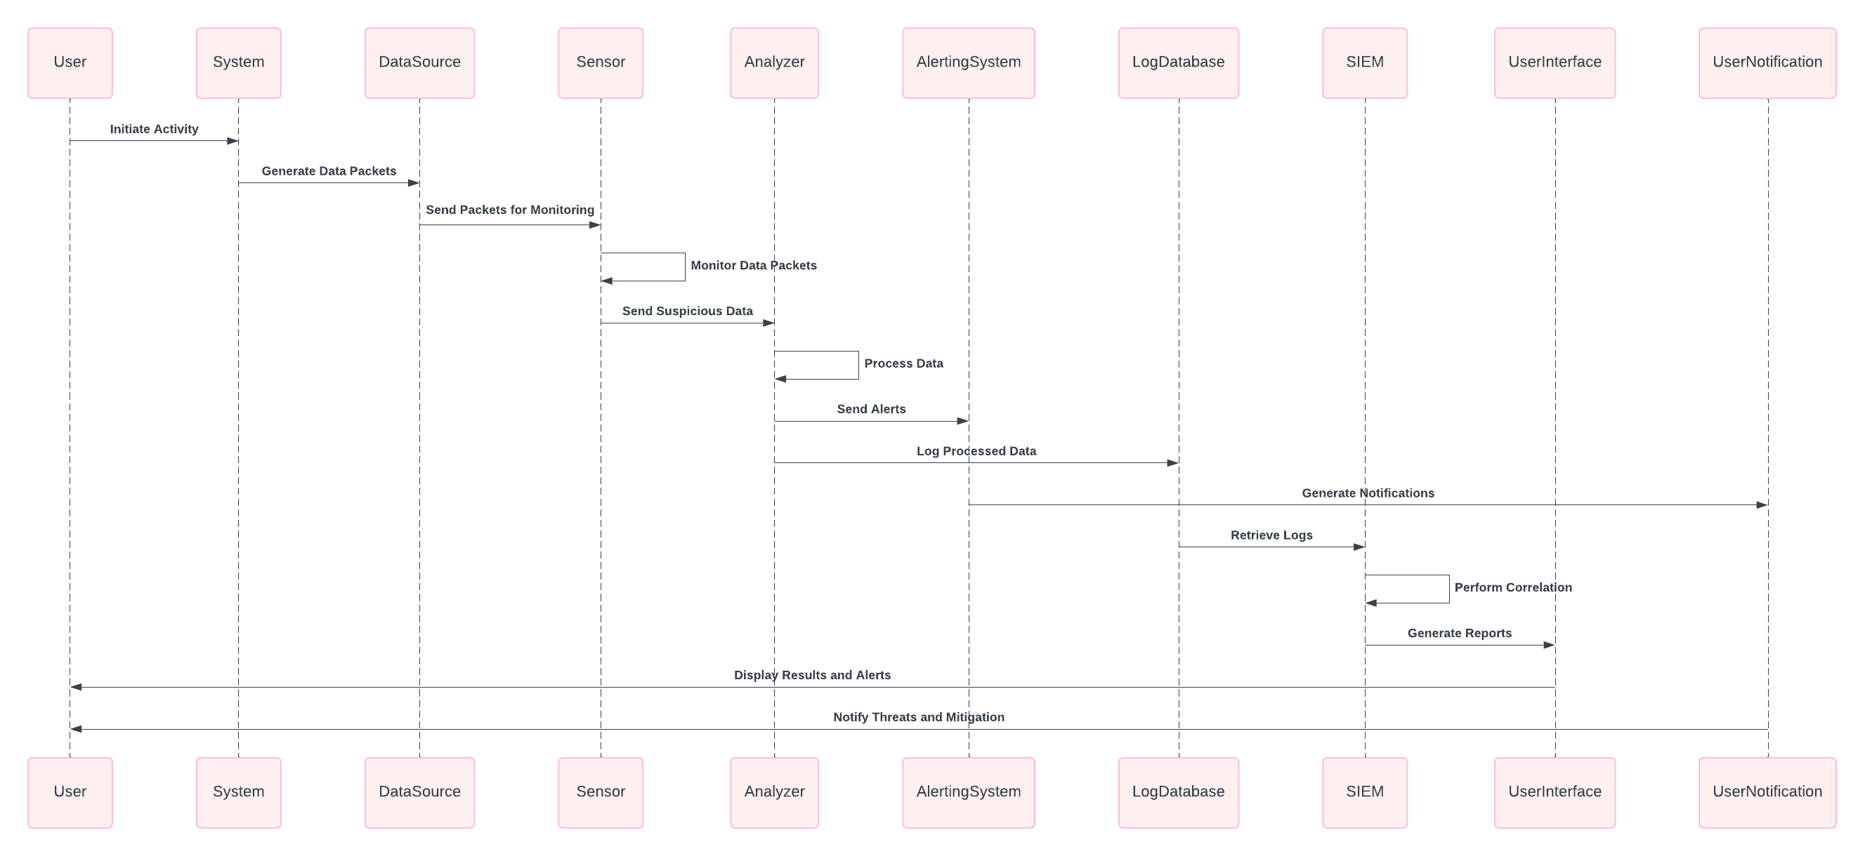
Sequence Diagram

Slide 23
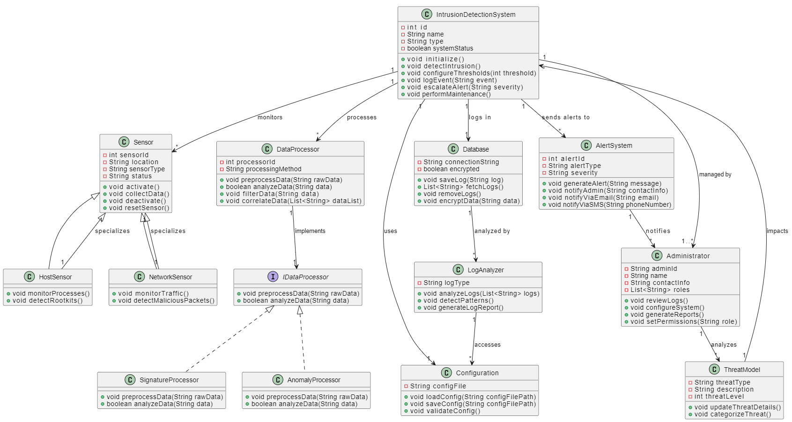
Class Diagram

Slide 24
Plan of Work
Methodology:
Data Gathering: Capture network traffic and analyze logs.
Feature Extraction: Process collected data to identify critical features for machine learning.
Model Development: Implement ML algorithms, including RNNs and clustering techniques.
Testing and Validation: Simulate various attack scenarios to test system effectiveness.
Deployment: Implement the IDS in the network infrastructure with user training.

Slide 25
Timeline
Month | Activity | Weeks | Tasks
Month 1 | Project Initiation and Planning | Weeks 1-2 | Identify project scope, objectives, and deliverables.
 |  | Week 3 | Conduct literature review and gather relevant works.
 |  | Week 4 | Finalize project proposal and outline SRS.
Month 2 | SRS Development and Review | Weeks 1-2 | Draft initial SRS document (functional and non-functional requirements).
 |  | Week 3 | Review and edit SRS based on guides’ comments.
 |  | Week 4 | Finalize SRS document.
Month 3 | System Design and Component Specification | Weeks 1-2 | Develop system architecture and create design diagrams with UI.
 |  | Week 3 | Create detailed component-level design specifications.
 |  | Week 4 | Conduct design review with guide for signoff.
Month 4 | Initial Coding, ML Implementation, and Testing | Weeks 1-2 | Begin coding core IDS functionalities.
 |  | Week 3 | Implement ML algorithms for anomaly detection.
 |  | Week 4 | Integrate networking components and conduct initial testing.
Month 5 | System Testing, Documentation, and Deployment | Week 1 | Perform unit, integration, and system testing.
 |  | Week 2 | Conduct user acceptance testing (UAT) with guides.
 |  | Week 3 | Finalize documentation and prepare deployment strategy.

Slide 26
Anticipated Outcomes
Security Enhancement: Strengthens network defenses with real-time, accurate threat detection and response.
Administrator Efficiency: Simplifies the management of security incidents with an intuitive interface and actionable insights.
Long-Term Usability: Detailed documentation ensures the system is maintainable and usable for extended periods.
Proactive Adaptation: Leverages machine learning to stay ahead of evolving threats, reducing vulnerabilities.

Slide 27
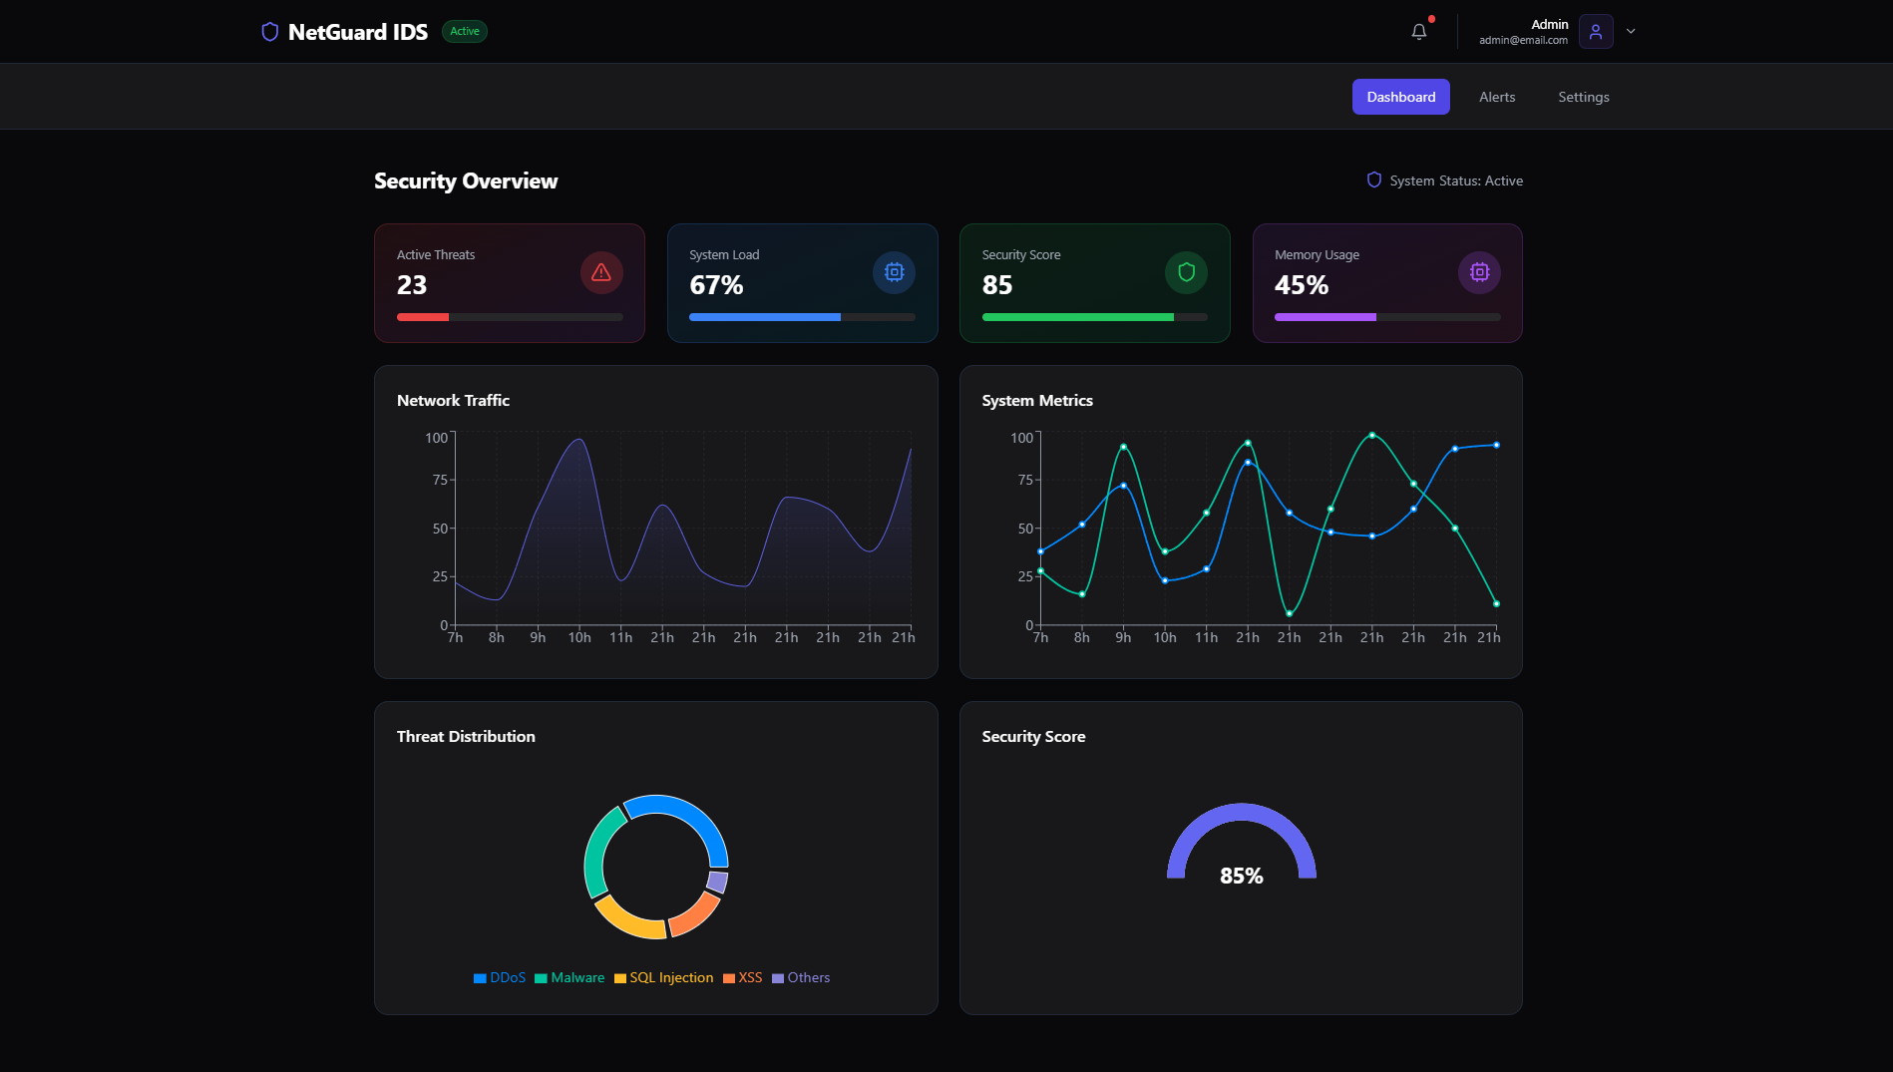
User Interface

Slide 28
Conclusion
The Need for a Modern IDS: The rise in sophisticated cyber threats necessitates the development of a robust and adaptable Intrusion Detection System (IDS). This is particularly important as traditional security solutions struggle to keep up with the complexity and volume of modern attacks.
Combining Strengths: A hybrid approach combining signature-based and anomaly-based detection techniques is proposed as the most effective way to address a wide range of threats. This approach leverages the accuracy of signature-based detection for known attacks and the adaptability of anomaly-based detection for identifying new and evolving threats.
Machine Learning's Role: Machine learning algorithms are central to enhancing the IDS's detection capabilities and enabling it to adapt to changing attack patterns. By learning from data, these algorithms can identify subtle anomalies and predict future attacks, significantly improving the system's effectiveness.
Feasibility and Resources: The conclusion emphasizes that the project is technically feasible, with available technologies and resources sufficient for developing a sophisticated IDS. This includes high-performance hardware, open-source software tools like Snort and appropriate programming languages and machine learning libraries.
Project Impact: The project aims to significantly strengthen network security by providing a real-time intrusion detection system with enhanced accuracy and adaptability. The research findings are also expected to contribute to broader advancements in intrusion detection technologies, benefitting both academic and industry applications.

Slide 29
References
[1] Patcha, A., & Park, J. M. (2007). An overview of anomaly detection techniques: Existing solutions and latest technological trends. Computer Networks, 51(12), 3448–3470. https://doi.org/10.1016/j.comnet.2007.02.001
[2] Koc, L., Mazzuchi, T. A., & Sarkani, S. (2012). A network intru sion detection system based on a Hidden Na¨ ıve Bayes multiclass classifier. Expert Systems with Applications, 39(18), 13492–13500. https://doi.org/10.1016/j.eswa.2012.07.009
[3] Liao, H. J., Richard Lin, C. H., Lin, Y. C., & Tung, K. Y. (2013). Intrusion detection system: A comprehensive review. In Journal of Network and Computer Applications (Vol. 36, Issue 1, pp. 16–24). https://doi.org/10.1016/j.jnca.2012.09.004
[4] Jang-Jaccard, J., & Nepal, S. (2014). A survey of emerging threats in cybersecurity. Journal of Computer and System Sciences, 80(5), 973 993. https://doi.org/10.1016/j.jcss.2014.02.005
[5] Ahmed, M., Naser Mahmood, A., & Hu, J. (2016). A survey of network anomaly detection techniques. In Journal of Network and Computer Applications (Vol. 60, pp. 19–31). Academic Press. https://doi.org/10.1016/j.jnca.2015.11.016

Slide 30
[6] Yin, C., Zhu, Y., Fei, J., & He, X. (2017). A Deep Learning Approach for Intrusion Detection Using Recurrent Neural Networks. IEEE Access, 5, 21954–21961. https://doi.org/10.1109/ACCESS.2017.2762418 [7] Khraisat, A., Gondal, I., Vamplew, P., & Kamruzzaman, J. (2019). Sur vey of intrusion detection systems: techniques, datasets and challenges. Cybersecurity, 2(1). https://doi.org/10.1186/s42400-019-0038-7
[8] Maseer, Z. K., Yusof, R., Bahaman, N., Mostafa, S. A., & Foozy, C. F. M. (2021). Benchmarking of Machine Learning for Anomaly Based Intrusion Detection Systems in the CICIDS2017 Dataset. IEEE Access, 9, 22351–22370. https://doi.org/10.1109/ACCESS.2021.3056614
[9] Nazir, A., & Khan, R. A. (2021). A novel combinatorial optimization based feature selection method for network intrusion detection. Com puters and Security, 102. https://doi.org/10.1016/j.cose.2020.102164
[10] Abu Al-Haija, Q., & Al-Badawi, A. (2021). Attack-Aware IoT Network Traffic Routing Leveraging Ensemble Learning. Sensors (Basel, Switzer land), 22(1). https://doi.org/10.3390/s2201024

